Slide 1
Sharath Chandra Kamuni Kavya Rampalli Bharath Sudha Chandra Bachala
Prepared by Team BUJJI:
Under the Guidance of: Prof. Shivanjali Khare

Slide 2

Shortest Route Discovery: The Travelling Salesman Problem

Slide 3
OBJECTIVE
We will implement and evaluate both the A3C (Asynchronous Actor-Critic) and Q-Learning algorithms to tackle the Traveling Salesman Problem (TSP). Our goal is to find the shortest route that visits each city exactly once and returns to the starting point. This project uses:
Q-Learning: A table-based model-free reinforcement learning algorithm.
A3C: Asynchronous Advantage Actor-Critic, a neural network-based RL method.
Compare the Algorithms in terms of performance metrics to identify the strengths and weaknesses of each approach in addressing the TSP.

Slide 4
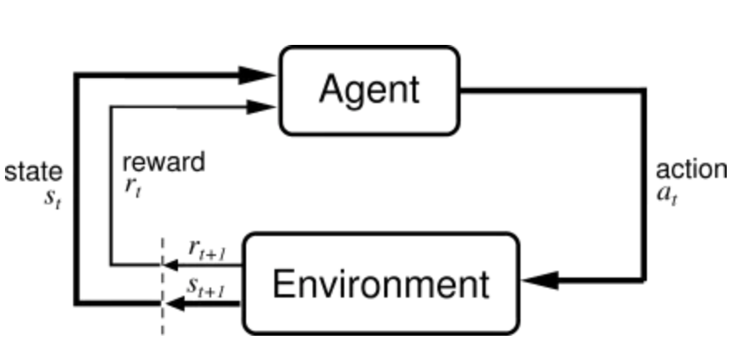
Problem and Solution Model
For solving the TSP there are some things that should be declared globally i.e., for solving the TSP we require
Environment, States, Actions, Agent, Value Function, Reward etc…
We are solving TSP using Model free RL Algorithms since it is better for scaling and flexible.
MFRL uses experience to directly learn state action values or policies as both plays the same role in reaching the optimal behavior we desire without estimation and world model.
MFRL agent relies on the trail and error method for finding out the optimal policy.
Q - Learning and A3C are two major approaches in MFRL.

Slide 5
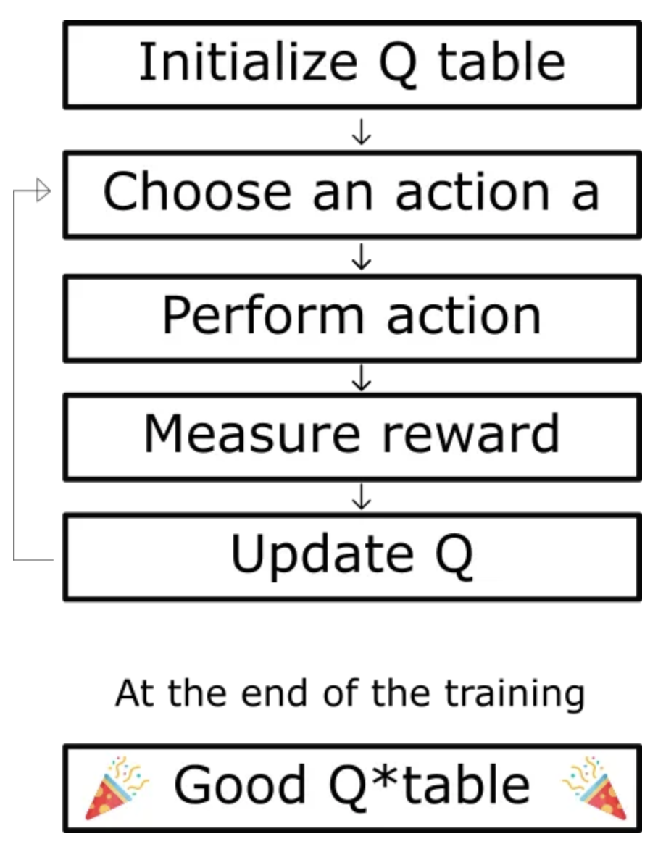
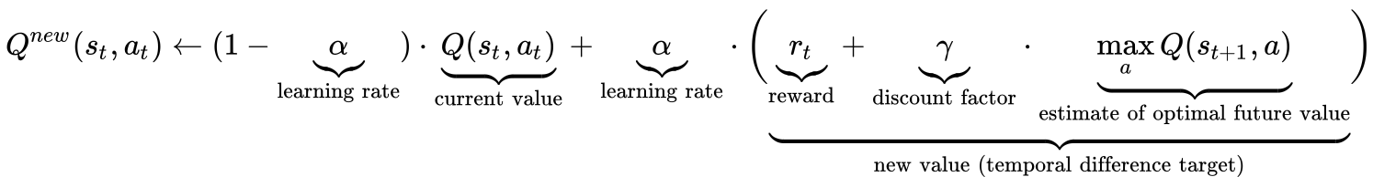
Q-Learning Algorithm for TSP
Q-table is a 2d matrix of state and action Q(s,a).
Actions can are taken in Q-learning are random and always less than exploration rate i.e., Q(s,a) with probability ϵ, then max(Q(s,a)) is 1-ϵ where( 0<ϵ<1).
During each iteration, the agent selects an action based on the current state. The choice of action involves a trade-off between exploration (trying new paths) and exploitation
The Q-table is initialized after taking the state-action pair.
Perform the chosen action, transition to the next state, and receive a reward(negative distance between the cities) as we are trying minimize the total distance travelled. 𝛾 is discount factor which affects the rewards.
We tune the hyper-parameters until we can observe a convergence.

Slide 6
A3C (Asynchronous Advantage Actor-Critic) Algorithm for TSP
1. Use an Actor-Critic Network with shared parameters for policy and value estimation.
2. Multiple asynchronous agents explore the environment in parallel.
3. Compute policy and value loss:
Policy Loss: -log(π(a|s)) * Advantage
Value Loss: (R - V(s))^2
4. Update global parameters based on local gradients.

Slide 7
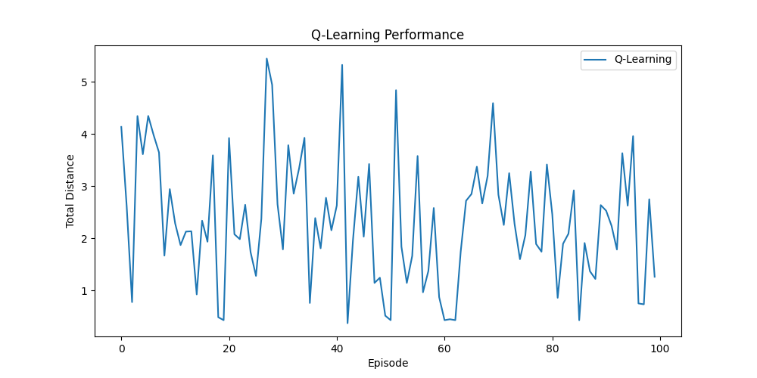
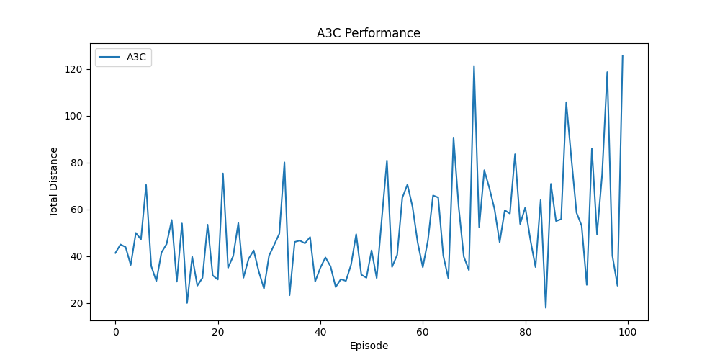
Outputs
We can observe that both the algorithm converges but the initial loss of Q-Learning is comparatively lower.

Slide 8

THANK YOU

